Slide 1
2015 IBM Academic Initiative Enterprise Systems Educators Conference
University of Arkansas - Fayetteville, AR
Monday, June 1st Willard J. Walker Hall (WJWH)
8:30 am Welcome and Breakfast - WJWH 124
University of Arkansas Faculty
- Dean Eli Jones
- David Douglas
IBM Academic Initiative Team
- Troy Crutcher, IBM
- Don Resnik, IBM
- Paul Newton, IBM
9:30 am Session 1: Strategies for Implementing System z into the Curriculum - WJWH 124
- David Douglas, University of Arkansas
- John Turchek, Robert Morris University
- Packy Laverty, Robert Morris University
- Susan Dischiave, Syracuse University
- Dave Dischiave, Syracuse University
- Cameron Seay, North Carolina A&T
- Don Resnik, IBM, Moderator
10:45 am Break
11:00 am Session 2: z Enterprise Skills for new Academic Educators (Hands-on) – WJWH 331
- Packy Laverty, Robert Morris University
12:00 pm Lunch – Walker 124
1:15 pm Session 3: RDz Lab (Hands-on) - WJWH 331
- Dave Dichiave, Syracuse University
2:15 pm Break
2:30 pm Session 4: Introduction to Analytics using SPSS Modeler on z: Part I (Hands-on) – WJWH 331
- David Douglas, University of Arkansas
3:30 pm Break
3:45 pm Session 5: Integrating Master the Mainframe into coursework, Registration for Materials (Hands- on) – WJWH 331
- Packy Laverty, Robert Morris University
6:00 pm Dinner with IBM - Hog Haus

Slide 2
2015 IBM Academic Initiative Enterprise Systems Educators Conference
University of Arkansas - Fayetteville, AR
Tuesday, June 2nd Willard J. Walker Hall (WJWH)
8:30 am Breakfast
9:00 am Session 6: Deeper Dive into Analytics using SPSS on z: Part II (Hands-on) – WJWH 331
- Xiao Ma, University of Arkansas
10:30 am Break
10:45 am Session 7: Getting started with OpenStack applications (Hands-on) – WJWH 331
- Dave Dichiave, Syracuse University
12:15 pm Lunch – Walker 124
1:15 pm Session 8: Cognos on Linux on z (Hands-on) – WJWH 331
- David Douglas, University of Arkansas
2:45 pm Break
3:00 pm Session 9: Employer Panel – WJWH 124
- Kim Henderson, Vice President: Information Services – Arkansas Blue Cross Blue Shield
- Todd Hill, Senior Manager, Hosting Operations, - Jack Henry & Associates
- Jeff Hines, Vice President: Information Services – Baldor
- Brandon McLamb, Director of Analytics – General Motors
6:00 pm Networking Happy Hour with University of Arkansas – Alumni House

Slide 3
2015 IBM Academic Initiative Enterprise Systems Educators Conference
University of Arkansas - Fayetteville, AR
Wednesday, June 3rd Willard J. Walker Hall (WJWH)
8:30 am Breakfast
9:00 am Session 10: z/OS in a Cloud Delivery Model – WJWH 124
- Randy Frerking – Walmart Stores, Inc.
- Rich Jackson – Walmart Stores, Inc.
10:30 am Break
10:45 am Session 11: Introduction to z/OS MF (Hands-on) - WJWH 331
- Paul Newton - IBM
12:15 pm Lunch – Closing Session – WJWH 124
- Complete Exit Surveys
- Distribute Additional Seminar Materials
- Farewell
1:30 pm End of Conference

Slide 4
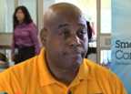
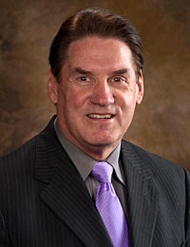
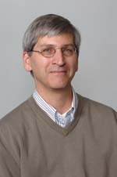
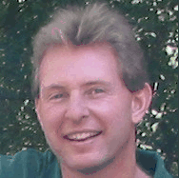
2015 IBM Academic Initiative Enterprise Systems Educators Conference
University of Arkansas - Fayetteville, AR
Biographies
Presenters
Cameron Seay, Professor, North Carolina A&T
Cameron Seay is an Assistant Professor of Information Technology in the School of Technology at North Carolina Agricultural and Technical State University in Greensboro, North Carolina. Dr. Seay’s research focus is on “enterprise systems,” or an enterprise-centric view of computing resources, cloud computing, and information technology pedagogy. His most recent work involves mainframe-based virtualization of Linux, open source virtual desktops, and using the Raspberry Pi as a virtual desktop. He is a founding member of the Enterprise Computing Community, which is the leading academic entity with a focus on enterprise systems. He holds a doctorate in educational psychology, and master’s degrees in business, information systems, and economics.
David Douglas, Professor, University of Arkansas
Dr. Douglas received his PhD in Industrial Engineering from the University of Arkansas. He teaches in a wide variety of information systems areas with emphasis on enterprise systems, global IT and business intelligence/knowledge management with emphasis on data mining and data warehouses. He has taught in several countries and presents workshops world-wide. He has received a number of honors and awards including International Educator of the year (IACIS), 2010 Majdi Najm Outstanding Service Award (SAP University Alliances), IBM International Professor of the month, two IBM faculty awards and NSF co-principal investigator for Enterprise Computing Community.
Dave Dischiave, Professor, Syracuse University
Dave Dischiave is an associate professor and the director of the Global Enterprise Technology Programs and the Systems & Information Science Program in the School of Information Studies at Syracuse University, where he teaches information management and technology courses.
Don Resnik, IBM Academic Initiative, z Systems, IBM
Don Resnik is the world wide leader for IBM System z Academic Initiative and Client Skills. Don is part of the Academic Initiative team that recruits and enables schools to teach System z. Don has 35 years of experience working with IBM mainframes in many different assignments.
Over the past 10 years, Don worked with hundreds of IBM customers to help them with their skills requirements and to start enterprise systems education programs in universities. He frequently facilitates meetings between industry and academia to start innovative enterprise systems education programs.
Don advocates that every student in CS, IT, IS, and even Business majors should be exposed to “Enterprise Systems” because the majority of the world’s data is running on IBM Enterprise Systems.

Slide 5
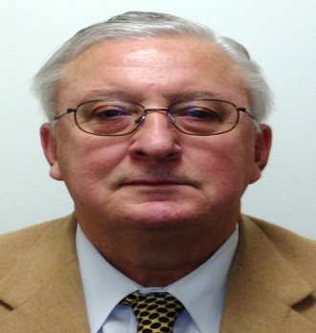
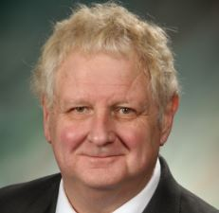
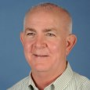
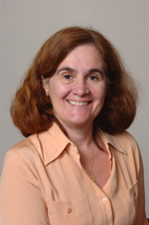
2015 IBM Academic Initiative Enterprise Systems Educators Conference
University of Arkansas - Fayetteville, AR
Biographies
John Turchek, Professor, Department Head, Robert Morris University
Extensive experience as a consultant in the following areas: accounting, computing, EDP auditing, education, information technology litigation, and project management. Clients have included major computer vendors, major steel manufacturers, colleges/universities, State Boards of Education, law firms, and small manufacturers.
Graduate and undergraduate courses in Strategic Information Systems Planning, Systems Analysis and Design, Object-Oriented Systems Analysis & Design, and Information Technology Project Management. Research areas include all of the preceding topics plus the following: business and information systems program accreditation, project management certification, project management program accreditation, the professions, security, e-commerce, and security.
Packy Laverty, Professor, Robert Morris University
Professor of Computer Information SystemsRobert Morris University
RMU CIS Department IBM zEnterprise Coordinator
RMU CIS Academic Virtual Systems Coordinator
Academic Degrees and Certifications: MBA, CMA,CRN, BA Economic and BS Accounting.
Current undergraduate and graduate courses includeINFS3212/INFS6212 Enterprise Operating Systems (z/OS), INFS2130/6130 COBOL, INFS3131/6231 Enterprise Transaction Systems (CICS), INFS4243/6243 Enterprise Database Systems (DB2), INFS4240/6240 Database Management Systems (Oracle), INFS6830 Secure Programming, INFS6490 Network and Operating System Security, and INFS3210/6210 Hardware and Operating Systems (Linux and Windows)
Recent Areas of Research Publications include Cloud Computing and Security, Mobile Security, IBM zEnterprise Academic Initiatives, and Online Course Delivery.
Paul Newton, Consulting IT Specialist, IBM
Paul Newton joined the IBM System z Academic Initiative team in 2004. If a university is willing to include System z technology into their curriculum, Paul technically enables the university. Paul has developed strong professional relationships with university faculty world wide through technical enablement during the past 10 years. Paul played a major role in designing and starting the first Master the Mainframe contest in 2004. Paul continues to play a major role by hosting the contest each year. Paul has technically assisted many independent software vendors port their applications to z/OS and Linux on System z since joining IBM in 1999. Paul's IT career prior to joining IBM included large enterprise technical development, support, services, and management applied to aircraft manufacturing, DOD, retail, distribution, and finance.
Susan Dischiave, Associate Professor, Syracuse University
Susan Dischiave is an associate professor and the director of the Information Management & Technology Program in the School of Information Studies at Syracuse University, where she teaches database management and technology courses.

Slide 6
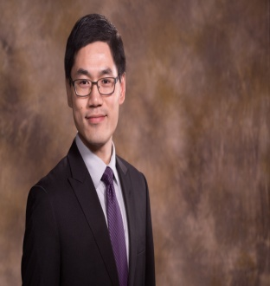
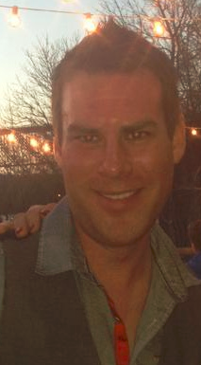
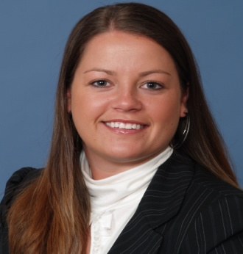
2015 IBM Academic Initiative Enterprise Systems Educators Conference
University of Arkansas - Fayetteville, AR
Biographies
Xiao Ma, Professor, University of Arkansas
Xiao (Sean) Ma is an Assistant Professor of Information Systems in the Sam M. Walton College of Business at the University of Arkansas. He holds a Ph.D. from University of Wisconsin-Madison. Xiao's teaching interests include business analytics, data analytics, and research methods. His research focuses on online gaming behavior and interventions, participation behavior in online communities, and the roles of habit and IT artifacts. He also studies the effect mechanisms of online auction website design. Xiao's research is published in premier information systems journals such as Information Systems Research and Journal of Management Information Systems.
2015 IBM Academic Initiative Enterprise Systems Educators Conference Event Coordinators
Troy Crutcher, IBM Academic Initiative, System z, IBM
Troy Crutcher graduated from Illinois State University in 2007 with a bachelors degree in Computer Science. While there, he completed an internship with IBM and started right away in the Build and Installation department upon graduation. In August of 2012, he joined the IBM Academic Initiative program. Currently, he works on university relations, with the intent to foster the next generation of enterprise systems programmers. He has recently became the new project manager for the Master the Mainframe Contest held world wide. In addition, he is the zNextGen representative for IBM.
Tricia Kelly, Administrator, University of Arkansas
Tricia Kelly graduated from Eastern Oregon University in 2004 with a bachelors degree in Business Administration. Tricia was a 4-year starter on the Women’s Basketball Team, which was recently inducted into the EOU Hall of Fame. Tricia was the Assistant Commissioner of the Great Northwest Athletic Conference (NCAA Division II) for seven years where she oversaw championships, compliance, National Letters of Intent and more. She then went on to work as an Office Manager in the Ticket Office at the University of Wisconsin before finding herself at the University of Arkansas as the Administrative Support Supervisor in the Department of Information Systems. She was recently promoted to Assistant Director of Information Systems Graduate Programs.

